Slide 1
Applied Mechanism Design For Social Good
John P Dickerson
Lecture #10 – 02/27/2020
CMSC828M
Tuesdays & Thursdays
2:00pm – 3:15pm

Slide 2
Announcements
Projects?
Slack! DM John! Email John! Chat with each other! Chat with anyone!
Short project summaries:
Due to John before Spring Break

Slide 3
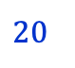
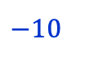
Turn-based Stochastic Games (TBSGs)
(Possibly) Infinite duration games played by two players, min and max, on a finite weighted directed graph.
Vertices of the graph divided among min, max and rand.
Edges emanating from min and max vertices, also called actions, have costs (or payoff)
Edges emanating from rand vertices have probabilities that sum up to 1.
There might be a sink, aka, a state with actions that lead only back to itself
$$20$$
$$−10$$
Uri Zwick

Slide 4
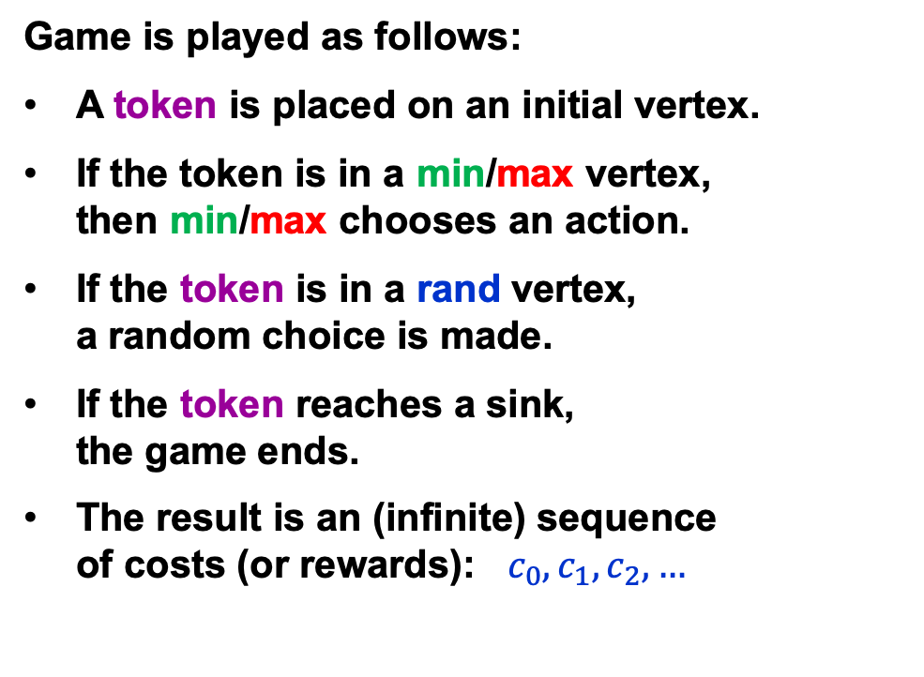
Turn-based Stochastic Games (TBSGs)
Game is played as follows:
A token is placed on an initial vertex.
If the token is in a min/max vertex, then min/max chooses an action.
If the token is in a rand vertex, a random choice is made.
If the token reaches a sink, the game ends.
The result is an (infinite) sequence of costs (or rewards): $c_{0},c_{1},c_{2},…$
$$20$$
$$−10$$
Uri Zwick

Slide 5
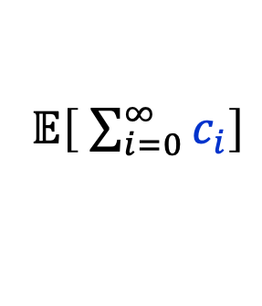
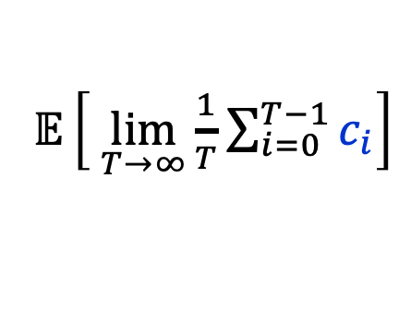
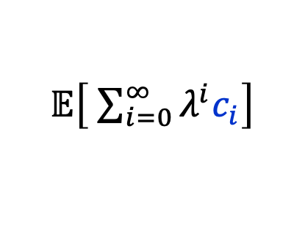
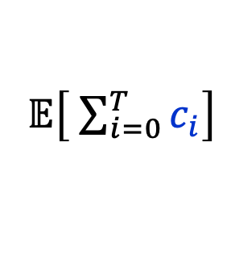
Turn-based Stochastic Games (TBSGs)
Objective function?
Total cost – finite horizon
min/max
$𝔼\left[ \sum_{i=0}^{T}{c_{i}}\right]$
Total cost – infinite horizon
$$20$$
$$−10$$
min/max
$𝔼\left[ \sum_{i=0}^{∞}{c_{i}}\right]$
Discounted cost
min/max
$𝔼\left[ \sum_{i=0}^{∞}{λ^{i}c_{i}}\right]$
Limiting average cost
min/max
$𝔼\left[ \lim_{T→∞}{\frac{1}{T}\sum_{i=0}^{T−1}{c_{i}}}\right]$
Uri Zwick

Slide 6
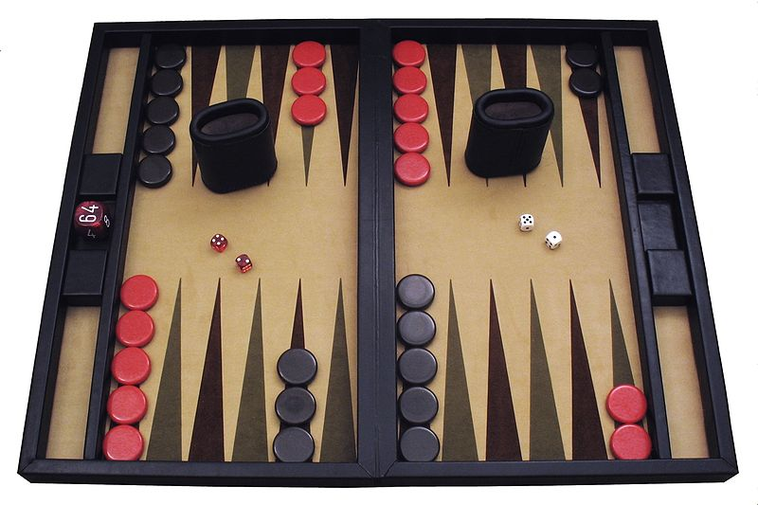
Backgammon
Backgammon is a TBSG.
Author: Ptkfgs Wikimedia Commons
A single cost/reward of $+1$ or $−1$ in the last move.
A huge number of vertices/states.
Stochasticity: dice rolls dictate legal states
Think back: can it be solved in polynomial time in the number of states ??????????
Uri Zwick

Slide 7
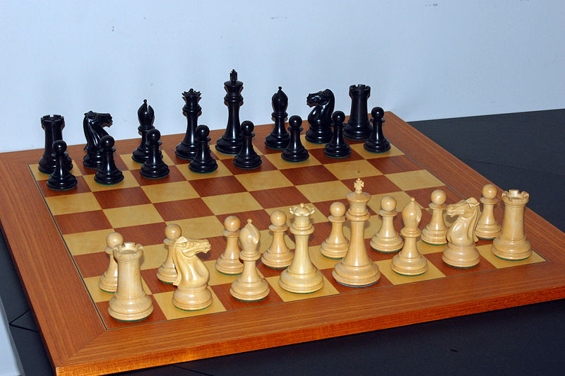
Chess
Chess is a deterministic TBSG.
Attribution: Bubba73 at English Wikipedia
A single cost/reward of $−1$, $0$ or $+1$ in the last move.
Finite? “Threefold repetition of position”

Slide 8
Let’s start even easier …

Slide 9
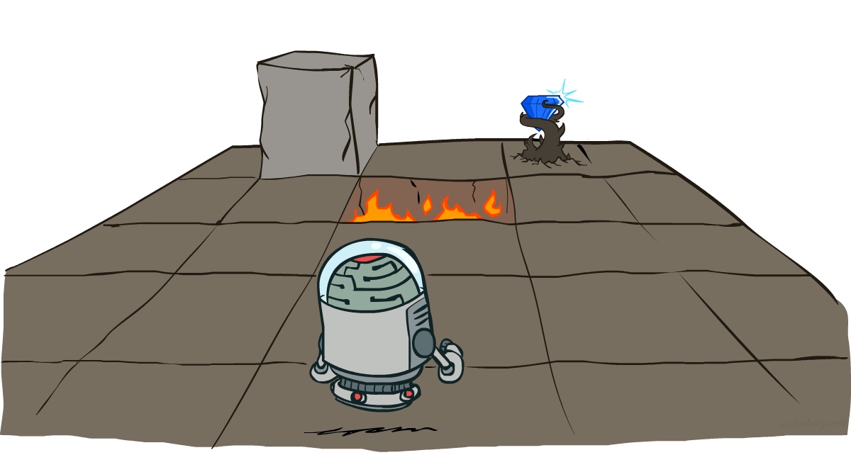
One-Player Stochastic Games aka Markov Decision Processes
Slide credits: CMU AI and http://ai.berkeley.edu

Slide 10
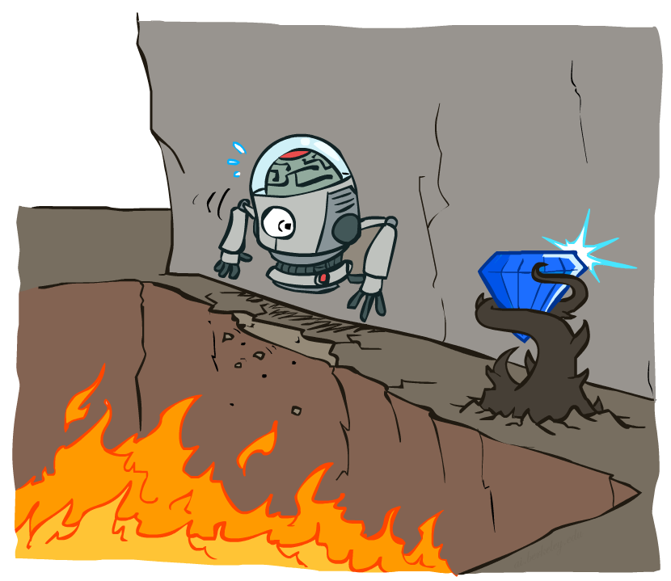
Non-Deterministic Search

Slide 11





Example: Grid World
A maze-like problem
The agent lives in a grid
Walls block the agent’s path
Noisy movement: actions do not always go as planned
If agent takes action North
80% of the time: Get to the cell on the North (if there is no wall there)
10%: West; 10%: East
If path after roll dice blocked by wall, stays put
The agent receives rewards each time step
“Living” reward (can be negative)
Additional reward at pit or target (good or bad) and will exit the grid world afterward
Goal: maximize sum of rewards
Notes:
If agent takes action North, then 80% of the time agent ends with going to the cell on the North (if there is no wall there)
10%, action North takes the agent West; 10% East
If there is a wall in the direction the agent would have been taken, the agent stays put
Small “living” reward each step (can be negative)
Big rewards come at the end (good or bad)

Slide 12
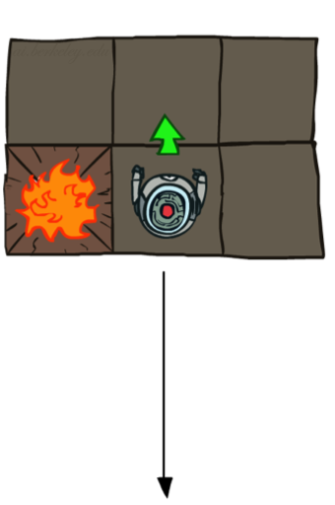
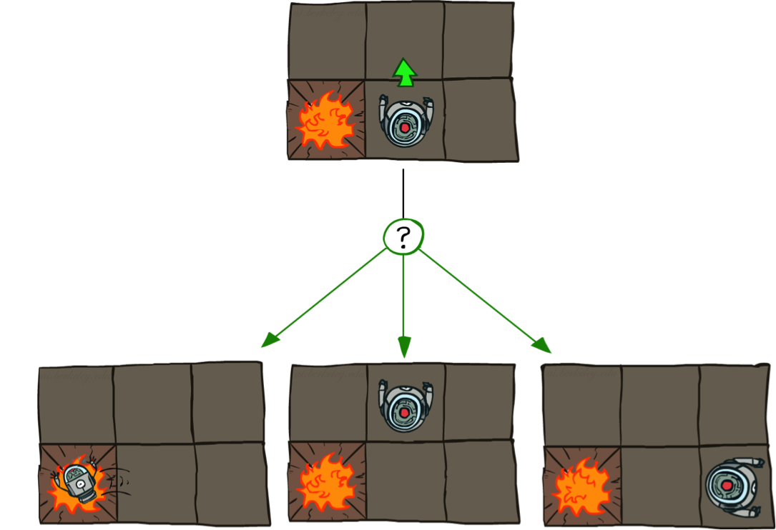

Grid World Actions
Deterministic Grid World
Stochastic Grid World

Slide 13
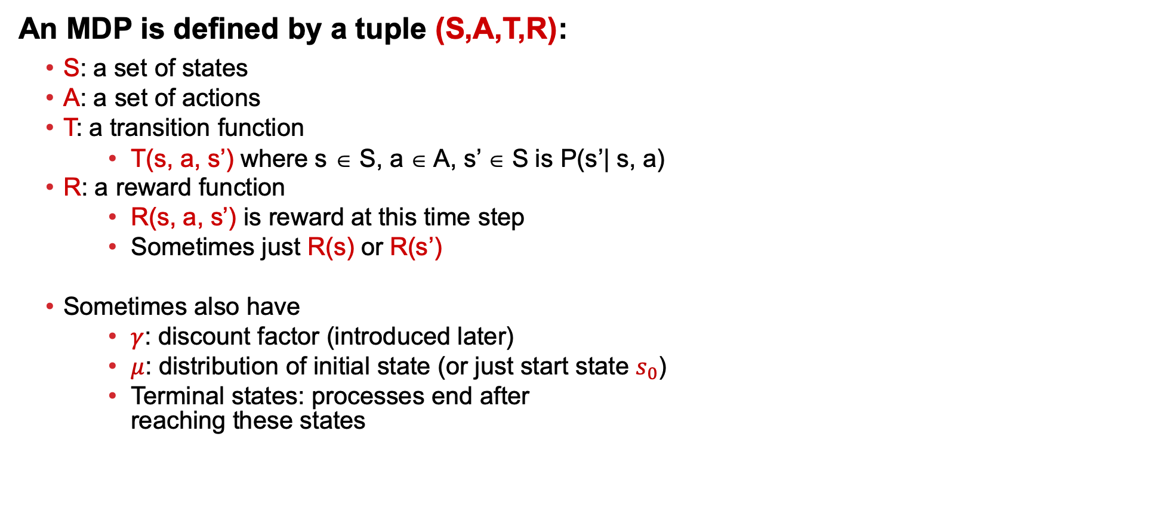
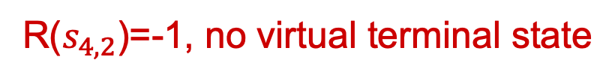
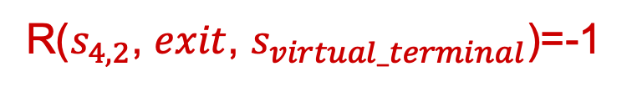
Markov Decision Process (MDP)
An MDP is defined by a tuple (S,A,T,R):
S: a set of states
A: a set of actions
T: a transition function
T(s, a, s’) where s ∈ S, a ∈ A, s’ ∈ S is P(s’| s, a)
R: a reward function
R(s, a, s’) is reward at this time step
Sometimes just R(s) or R(s’)
Sometimes also have
$γ$: discount factor (introduced later)
$μ$: distribution of initial state (or just start state $s_{0}$)
Terminal states: processes end after reaching these states
The Grid World problem as an MDP
R($s_{4,2}$, $exit$, $s_{virtual_terminal}$)=-1
R($s_{4,2}$)=-1, no virtual terminal state
How to define the terminal states & reward function for the Grid World problem?
Notes:
T(s,a,s’): Probability that a from s leads to s’
T is also called the model or the dynamics
In search problems: did not talk about actions, but about successor functions --- now the information inside the successor function is unpacked into actions, transitions and reward
Write out S, A, example entry in T, entry in R
Reward function different from the book : R(s,a,s’)
In book simpler for equations, but not useful for the projects.
Need to modify expectimax a tiny little bit to account for rewards along the way, but that’s something you should be able to do, and so you can already solve MDP’s (not in most efficient way)

Slide 14
Markov Decision Process (MDP)
An MDP is defined by a tuple (S,A,T,R)
Why is it called Markov Decision Process?
Decision:
Process:
Notes:
T(s,a,s’): Probability that a from s leads to s’
T is also called the model or the dynamics
In search problems: did not talk about actions, but about successor functions --- now the information inside the successor function is unpacked into actions, transitions and reward
Write out S, A, example entry in T, entry in R
Reward function different from the book : R(s,a,s’)
In book simpler for equations, but not useful for the projects.
Need to modify expectimax a tiny little bit to account for rewards along the way, but that’s something you should be able to do, and so you can already solve MDP’s (not in most efficient way)

Slide 15
Markov Decision Process (MDP)
An MDP is defined by a tuple (S,A,T,R)
Why is it called Markov Decision Process?
Decision:
Process:
Agent decides what action to take at each time step
The system (environment + agent) is changing over time
Notes:
T(s,a,s’): Probability that a from s leads to s’
T is also called the model or the dynamics
In search problems: did not talk about actions, but about successor functions --- now the information inside the successor function is unpacked into actions, transitions and reward
Write out S, A, example entry in T, entry in R
Reward function different from the book : R(s,a,s’)
In book simpler for equations, but not useful for the projects.
Need to modify expectimax a tiny little bit to account for rewards along the way, but that’s something you should be able to do, and so you can already solve MDP’s (not in most efficient way)

Slide 16

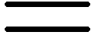
What is “Markovian” about MDPs?
Markov property: Conditional on the present state, the future and the past are independent
With respect to MDPs, it means outcome of an action depend only on current state
Andrey Markov
(1856-1922)
Russian mathematician
Notes:
Roughly speaking, a process satisfies the Markov property if one can make predictions for the future of the process based solely on its present state just as well as one could knowing the process's full history, hence independently from such history, that is, conditional on the present state of the system, its future and past states are independent.
(sometimes characterized as "memorylessness")
Like search: successor function only depended on current state
Can make this happen by stuffing more into the state;
Very similar to search problems: when solving a maze with food pellets, we stored which food pellets were eaten

Slide 17

Policies
In deterministic single-agent search problems, we wanted an optimal plan, or sequence of actions, from start to a goal
For MDPs, we focus on policies
Policy = map of states to actions
π(s) gives an action for state s
We want an optimal policy π*: S → A
An optimal policy is one that maximizes expected utility if followed

Slide 18
Policies
Recall: An MDP is defined S,A,T,R
Keep S,A,T fixed, optimal policy may vary given different R
What is the optimal policy if R(s,a,s’)=-1000 for all states other than pit and target?
What is the optimal policy if R(s,a,s’)=0 for all states other than pit and target, and reward=1000 and -1000 at pit and target respectively?

Slide 19
Discussion Point!
{A, B, C, D} are optimal policies for one of each of the following “reward for living” scenarios: {-0.01, -0.03, -0.04, -2.0}. Which policy maps to which reward setting?
{B, A, C, D}
{B, C, A, D}
{C, B, A, D}
{D, A, C, B}
A)
B)
C)
D)
Notes:
R(s) = the “living reward”

Slide 20
Discussion Point!
{A, B, C, D} are optimal policies for one of each of the following “reward for living” scenarios: {-0.01, -0.03, -0.04, -2.0}. Which policy maps to which reward setting?
{B, A, C, D}
{B, C, A, D}
{C, B, A, D}
{D, A, C, B}
A)
B)
C)
D)
Notes:
R(s) = the “living reward”

Slide 21
Discussion Point! Policies
R(s) = -0.01
R(s) = -0.03
R(s) = -0.4
R(s) = -2.0
Notes:
R(s) = the “living reward”

Slide 22
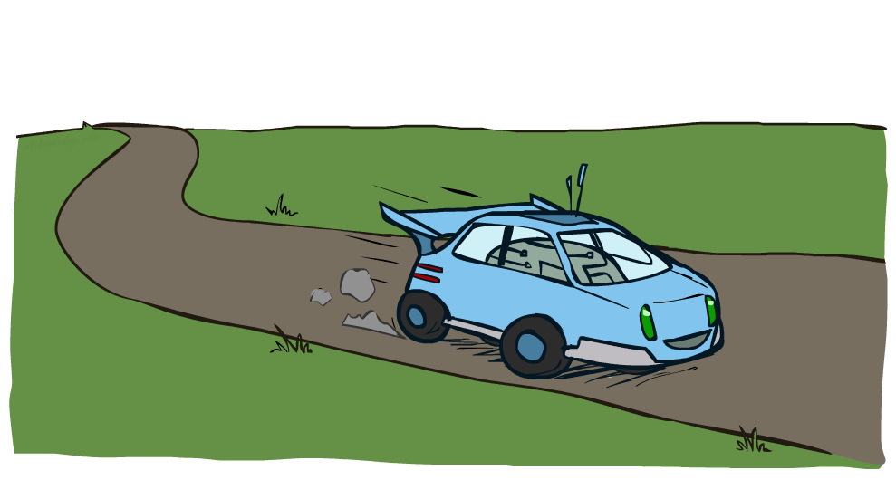
Example: Racing

Slide 23
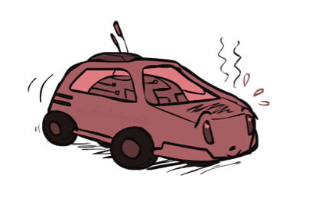
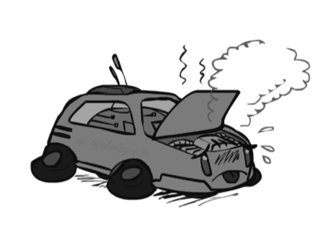

Example: Racing
A robot car wants to travel far, quickly
Three states: Cool, Warm, Overheated
Two actions: Slow, Fast
Going faster gets double reward
0.5
+1
1.0
Fast
Slow
-10
+1
0.5
Warm
Slow
Fast
0.5
+2
Cool
0.5
Overheated
+1
1.0
+2

Slide 24



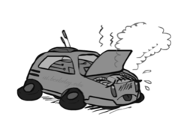
Racing Search Tree

Slide 25


MDP Search Trees
Each MDP state projects a search tree
s
s is a state
a
(s, a) is a q-state
s, a
(s,a,s’) called a transition
T(s,a,s’) = P(s’|s,a)
R(s,a,s’)
s,a,s’
s’
Notes:
In MDP chance node represents uncertainty about what might happen based on (s,a) [as opposed to being a random adversary]
Q-state (s,a) is when you were in a state and took an action

Slide 26
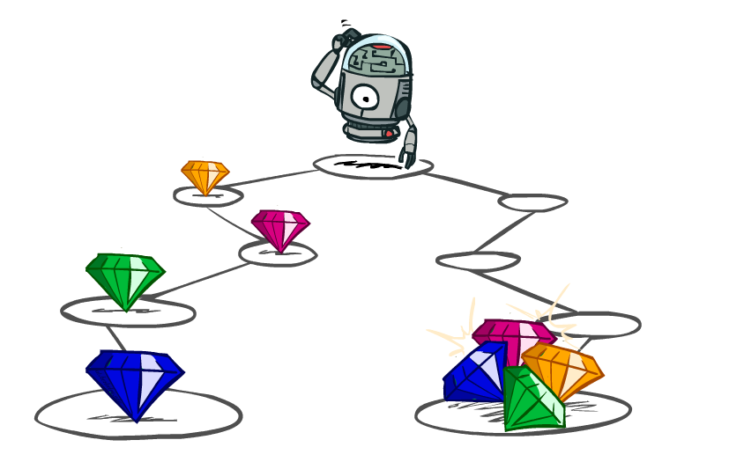
Utilities of Sequences

Slide 27
Utilities of Sequences
What preferences should an agent have over reward sequences?
More or less?
Now or later?
[1, 2, 2]
or
[2, 3, 4]
[0, 0, 1]
or
[1, 0, 0]

Slide 28





Discounting
It’s reasonable to maximize the sum of rewards
It’s also reasonable to prefer rewards now to rewards later
One solution: utility of rewards decay exponentially
Worth Now
Worth Next Step
Worth In Two Steps

Slide 29

Discounting
How to discount?
Each time we descend a level, we multiply in the discount once
Why discount?
Sooner rewards probably do have higher utility than later rewards
Also helps our algorithms converge
Notes:
Rewards in the future (deeper in the tree) matter less
Interesting: running expectimax, if having to truncate the search, then not losing much; e.g., less then \gamma^d / (1-\gamma)

Slide 30
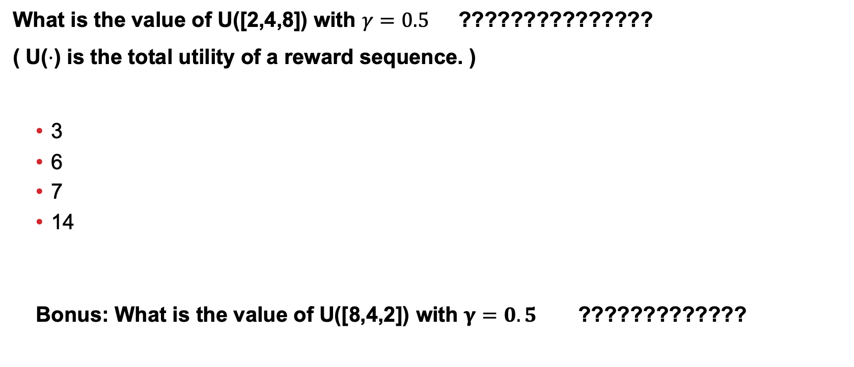
Discussion Point!
What is the value of U([2,4,8]) with $γ=0.5$ ???????????????
( U($⋅$) is the total utility of a reward sequence. )
3
6
7
14
Bonus: What is the value of U([8,4,2]) with $γ=0.5$ ?????????????
Notes:
Rewards in the future (deeper in the tree) matter less
Interesting: running expectimax, if having to truncate the search, then not losing much; e.g., less then \gamma^d / (1-\gamma)

Slide 31
Discussion Point!
What is the value of U([2,4,8]) with $γ=0.5$ ???????????????
( U($⋅$) is the total utility of a reward sequence. )
3
6
7
14
Bonus: What is the value of U([8,4,2]) with $γ=0.5$ ?????????????
$$γ^{0}×2+γ^{1}×4+γ^{2}×8=2+0.5×4+0.5×0.5×8=2+2+2=6$$
$$γ^{0}×8+γ^{1}×4+γ^{2}×2=8+0.5×4+0.5×0.5×2=8+2+0.5=10.5$$
Notes:
Rewards in the future (deeper in the tree) matter less
Interesting: running expectimax, if having to truncate the search, then not losing much; e.g., less then \gamma^d / (1-\gamma)

Slide 32
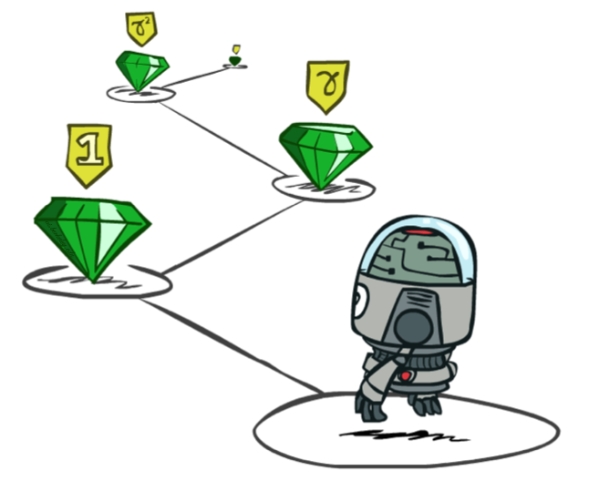
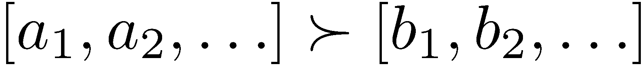
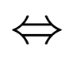
Stationary Preferences
Theorem: if we assume stationary preferences:
Then: there are only two ways to define utilities
Additive utility:
Discounted utility:

Slide 33

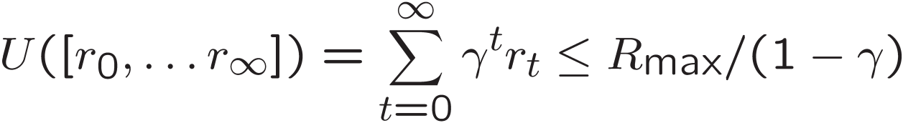
Infinite Utilities?!
Problem: What if the game lasts forever? Do we get infinite rewards?
Solutions:
Finite horizon: (similar to depth-limited search)
Terminate episodes after a fixed T steps (e.g. life)
Gives nonstationary policies (π depends on time left)
Discounting: use 0 < γ < 1
Smaller γ means smaller “horizon” – shorter term focus
Absorbing state: guarantee that for every policy, a terminal state will eventually be reached (like “overheated” for racing)

Slide 34

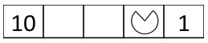
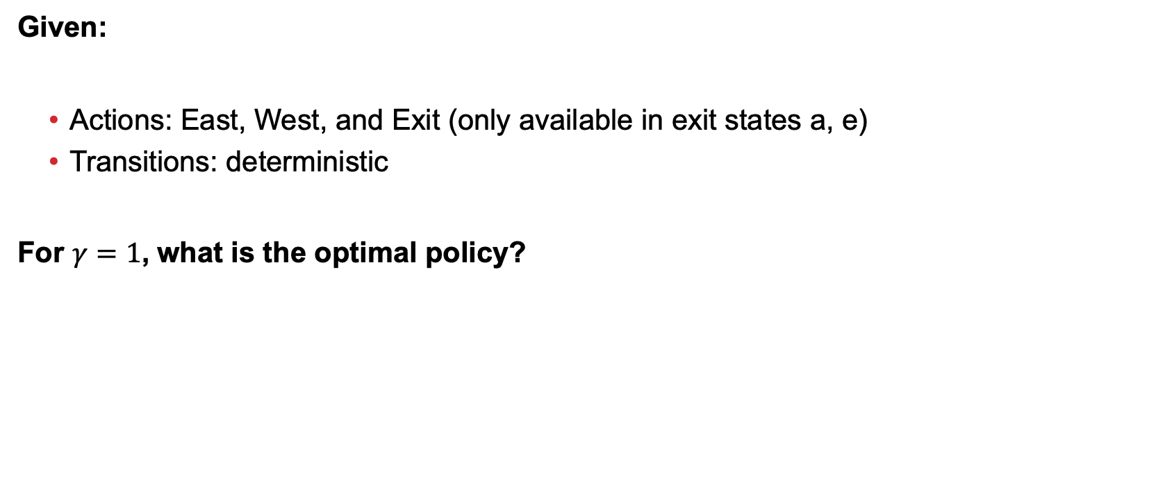
Optimal Policy with Discounting
Given:
Actions: East, West, and Exit (only available in exit states a, e)
Transitions: deterministic
For $γ=1$, what is the optimal policy?

Slide 35
Optimal Policy with Discounting
Given:
Actions: East, West, and Exit (only available in exit states a, e)
Transitions: deterministic
For $γ=1$, what is the optimal policy?

Slide 36
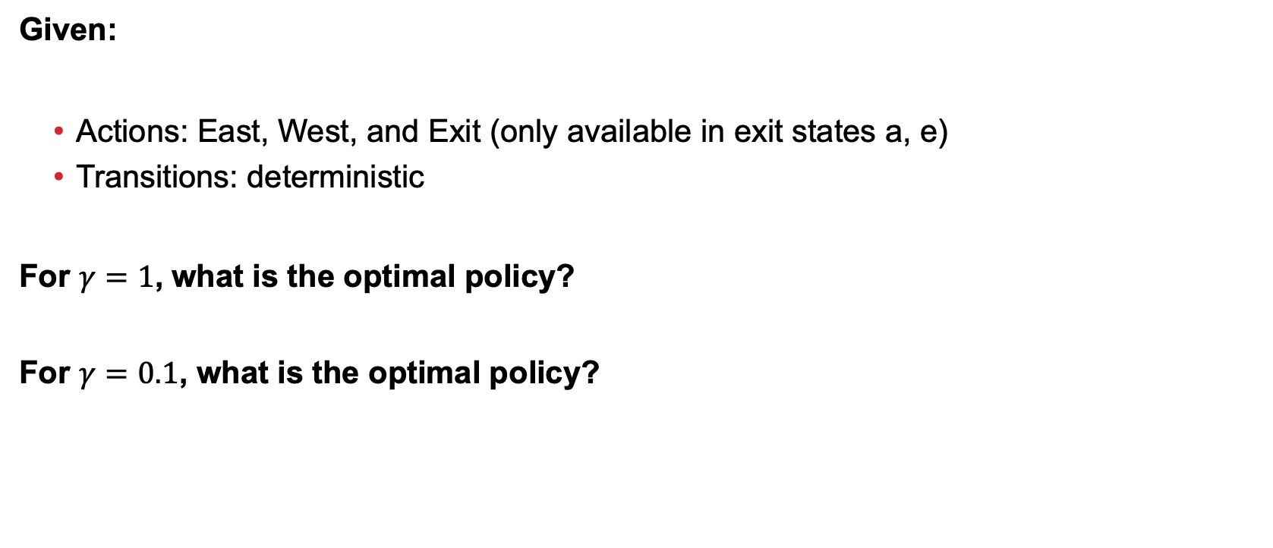
Optimal Policy with Discounting
Given:
Actions: East, West, and Exit (only available in exit states a, e)
Transitions: deterministic
For $γ=1$, what is the optimal policy?
For $γ=0.1$, what is the optimal policy?

Slide 37
Optimal Policy with Discounting
Given:
Actions: East, West, and Exit (only available in exit states a, e)
Transitions: deterministic
For $γ=1$, what is the optimal policy?
For $γ=0.1$, what is the optimal policy?

Slide 38
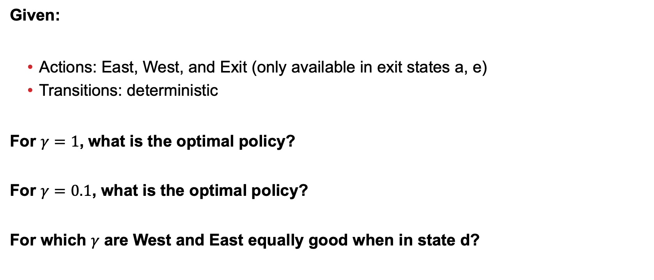
Optimal Policy with Discounting
Given:
Actions: East, West, and Exit (only available in exit states a, e)
Transitions: deterministic
For $γ=1$, what is the optimal policy?
For $γ=0.1$, what is the optimal policy?
For which $γ$ are West and East equally good when in state d?

Slide 39
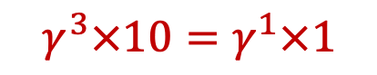
Optimal Policy with Discounting
Given:
Actions: East, West, and Exit (only available in exit states a, e)
Transitions: deterministic
For $γ=1$, what is the optimal policy?
For $γ=0.1$, what is the optimal policy?
For which $γ$ are West and East equally good when in state d?
$$γ^{3}×10=γ^{1}×1$$

Slide 40
MDP Quantities (So Far!)
s
Markov decision processes:
States S
Actions A
Transitions P(s’|s,a) (or T(s,a,s’))
Rewards R(s,a,s’) (and discount γ)
Start state s0
MDP quantities so far:
Policy = map of states to actions
Utility = sum of (discounted) rewards
a
s, a
s,a,s’
s’

Slide 41
Solving MDPs

Slide 42
MDP Quantities
Markov decision processes:
States S
Actions A
Transitions P(s’|s,a) (or T(s,a,s’))
Rewards R(s,a,s’) (and discount γ)
Start state s₀
MDP quantities:
Policy = map of states to actions
Utility = sum of (discounted) rewards
(State) Value = expected utility starting from a state (max node)
Q-Value = expected utility starting from a state-action pair, i.e., q-state (chance node)
s
a
s, a
s,a,s’
s’

Slide 43
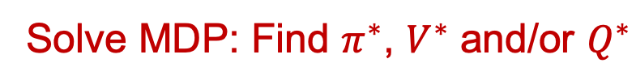
MDP Optimal Quantities
s
s is a state
a
The optimal policy:
π*(s) = optimal action from state s
The (true) value (or utility) of a state s:
V*(s) = expected utility starting in s and acting optimally
The (true) value (or utility) of a q-state (s,a):
Q*(s,a) = expected utility starting out having taken action a from state s and (thereafter) acting optimally
s, a
(s, a) is a q-state
(s,a,s’) is a transition
s,a,s’
s’
Solve MDP: Find $π^{∗}$, $V^{∗}$ and/or $Q^{∗}$
Notes:
Demo just shows V and Q values, snapshots on next slides.

Slide 44
Examples where we assume we have V and Q Values …

Slide 45
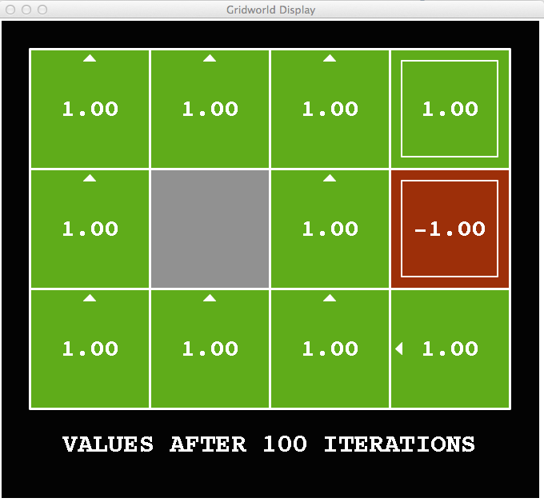
Gridworld V Values
Noise = 0
Discount = 1
Living reward = 0
Notes:
This demo doesn’t show anything in action, it just shows the V and Q values.

Slide 46
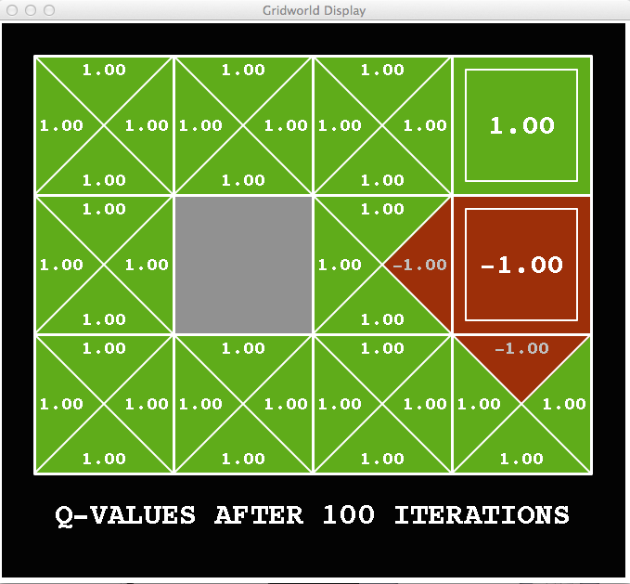
Gridworld Q Values
Noise = 0
Discount = 1
Living reward = 0
Notes:
This demo doesn’t show anything in action, it just shows the V and Q values.

Slide 47

Gridworld V Values
Noise = 0.2
Discount = 1
Living reward = 0
Notes:
This demo doesn’t show anything in action, it just shows the V and Q values.

Slide 48
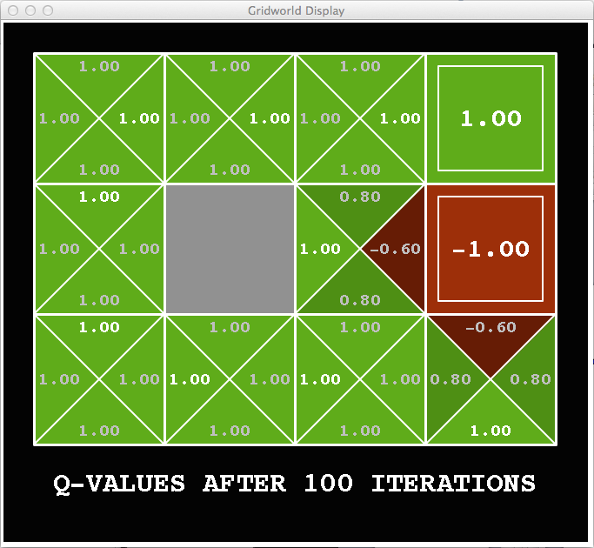
Gridworld Q Values
Noise = 0.2
Discount = 1
Living reward = 0
Notes:
This demo doesn’t show anything in action, it just shows the V and Q values.

Slide 49
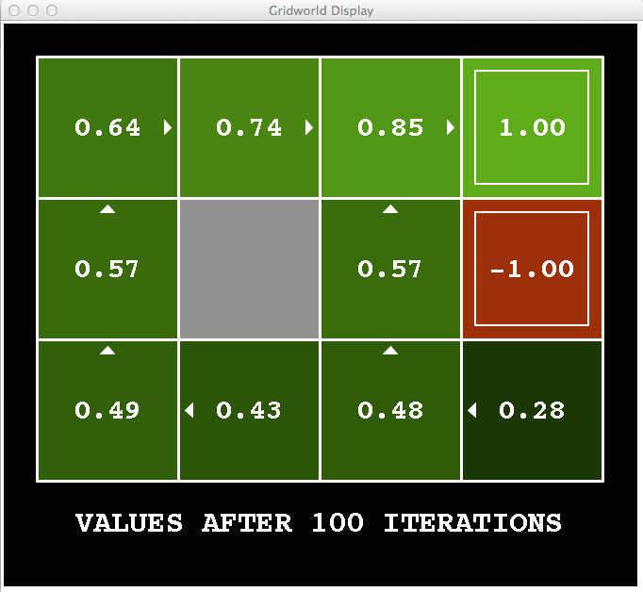
Gridworld V Values
Noise = 0.2
Discount = 0.9
Living reward = 0
Notes:
This demo doesn’t show anything in action, it just shows the V and Q values.

Slide 50
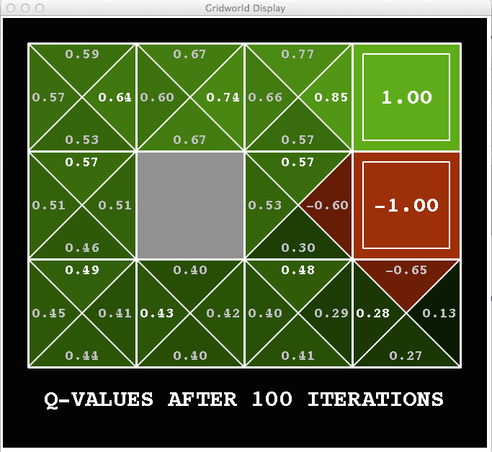
Gridworld Q Values
Noise = 0.2
Discount = 0.9
Living reward = 0
Notes:
This demo doesn’t show anything in action, it just shows the V and Q values.

Slide 51
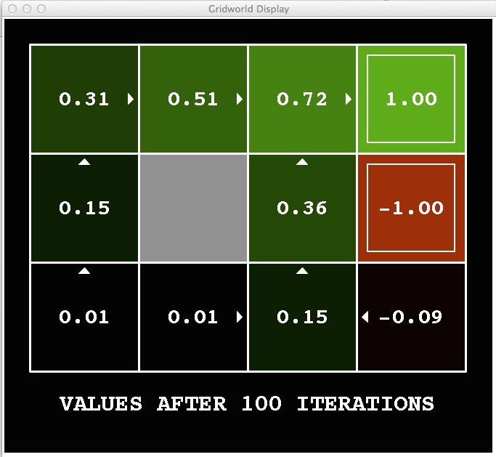
Gridworld V Values
Noise = 0.2
Discount = 0.9
Living reward = -0.1
Notes:
This demo doesn’t show anything in action, it just shows the V and Q values.

Slide 52
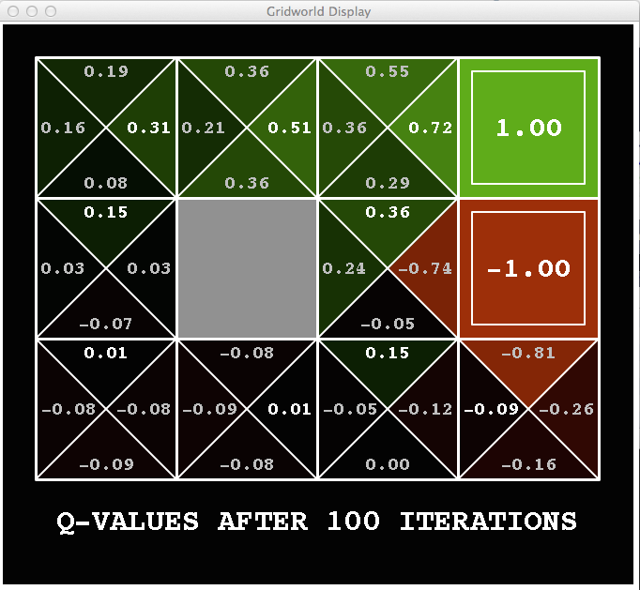
Gridworld Q Values
Noise = 0.2
Discount = 0.9
Living reward = -0.1
Notes:
This demo doesn’t show anything in action, it just shows the V and Q values.

Slide 53
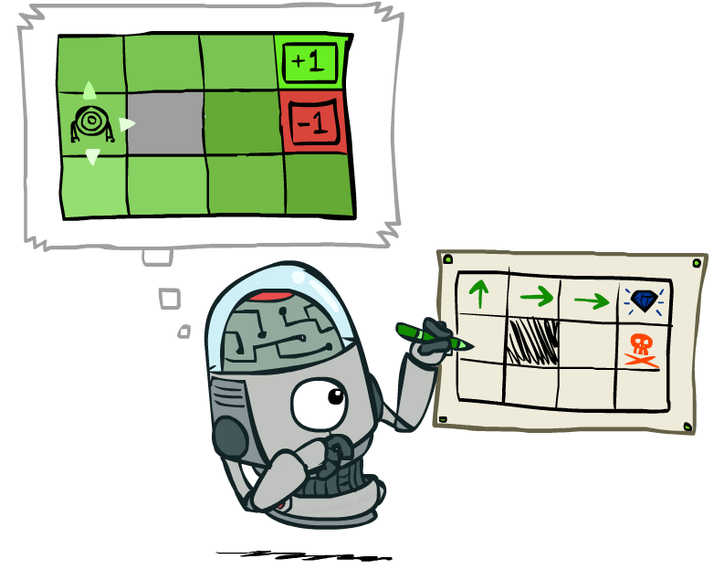
Computing Optimal Policy from Values

Slide 54
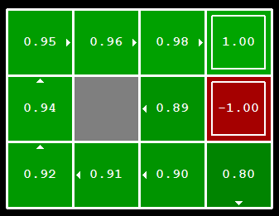
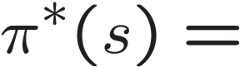
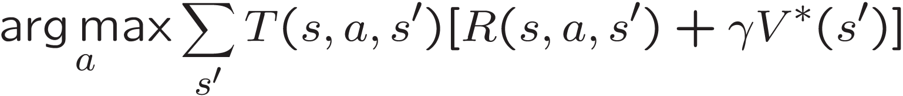
Computing Optimal Policy from Values
Let’s imagine we have the optimal values V*(s)
How should we act?
We need to do a mini-expectimax (one step)
Sometimes this is called policy extraction, since it gets the policy implied by the values
s
a
s, a
s,a,s’
s’

Slide 55
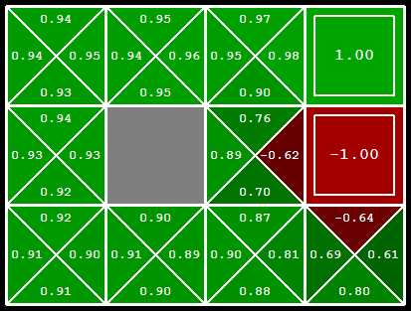
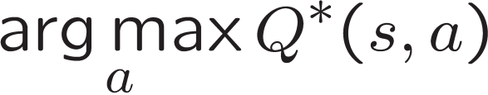
Computing Optimal Policy from Q-Values
Let’s imagine we have the optimal q-values:
How should we act?
Completely trivial to decide!
Important lesson: actions are easier to select from q-values than values!
So, how do we compute these state values and q-values?

Slide 56

The Bellman Equations
How to be optimal:
Step 1: Take correct first action
Step 2: Keep being optimal

Slide 57


Bellman Equations: The Value of A State
Fundamental operation: compute the (expectimax) value of a state
Expected utility under optimal action
Average sum of (discounted) rewards
Recursive definition of value:
s
a
s, a
s,a,s’
s’

Slide 58
Racing Search Tree

Slide 59


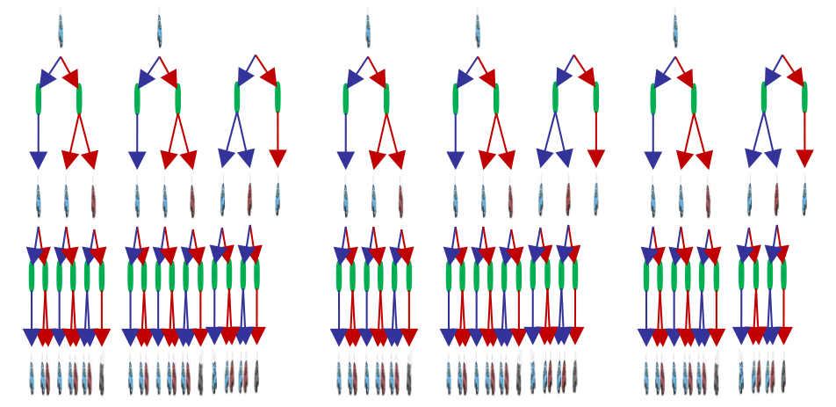

Racing Search Tree
Enumerate all paths, determine value of each path, choose path with highest value (aka expectimax)…?

Slide 60
Racing Search Tree
We’re doing way too much work with expectimax!
Problem: States are repeated
Idea: Only compute needed quantities once
Problem: Tree goes on forever
Idea: Do a depth-limited computation, but with increasing depths until change is small
Note: deep parts of the tree eventually don’t matter if γ < 1

Slide 61


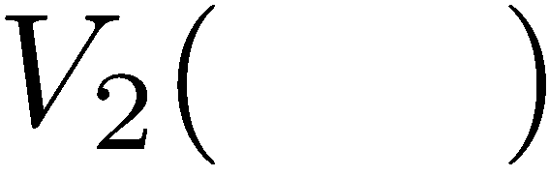

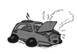
Time-Limited Values
Key idea: time-limited values
Define V_{k}(s) to be the optimal value of s if the game ends in k more time steps
Equivalently, it’s what a depth-k expectimax would give from s
Notes:
This demo generates the time-limited values for gridworld as snapshotted onto the next slides.

Slide 62
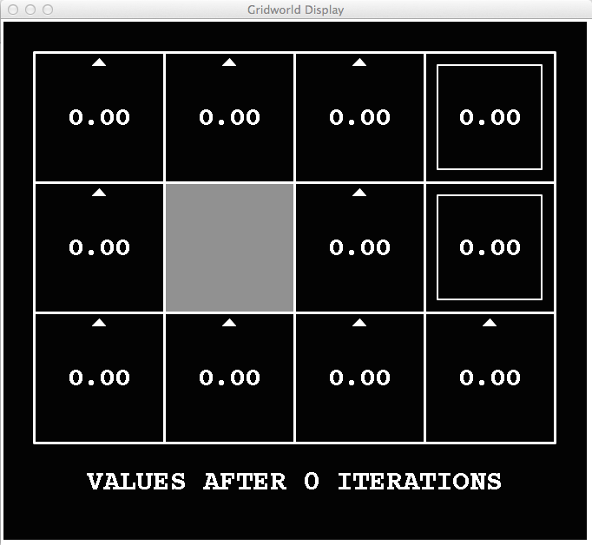
k=0
(Also watch the actions change as we go along.)
Noise = 0.2
Discount = 0.9
Living reward = 0
Notes:
Assuming zero living reward

Slide 63

k=1
Noise = 0.2
Discount = 0.9
Living reward = 0
Notes:
Assuming zero living reward

Slide 64

k=2
Noise = 0.2
Discount = 0.9
Living reward = 0
Notes:
Assuming zero living reward

Slide 65

k=3
Noise = 0.2
Discount = 0.9
Living reward = 0
Notes:
Assuming zero living reward

Slide 66

k=4
Noise = 0.2
Discount = 0.9
Living reward = 0
Notes:
Assuming zero living reward

Slide 67

k=5
Noise = 0.2
Discount = 0.9
Living reward = 0
Notes:
Assuming zero living reward

Slide 68

k=6
Noise = 0.2
Discount = 0.9
Living reward = 0
Notes:
Assuming zero living reward

Slide 69

k=7
Noise = 0.2
Discount = 0.9
Living reward = 0
Notes:
Assuming zero living reward

Slide 70

k=8
Noise = 0.2
Discount = 0.9
Living reward = 0
Notes:
Assuming zero living reward

Slide 71

k=9
Noise = 0.2
Discount = 0.9
Living reward = 0
Notes:
Assuming zero living reward

Slide 72

k=10
Noise = 0.2
Discount = 0.9
Living reward = 0
Notes:
Assuming zero living reward

Slide 73

k=11
Noise = 0.2
Discount = 0.9
Living reward = 0
Notes:
Assuming zero living reward

Slide 74

k=12
Noise = 0.2
Discount = 0.9
Living reward = 0
Notes:
Assuming zero living reward

Slide 75

k=100
Noise = 0.2
Discount = 0.9
Living reward = 0
Notes:
Assuming zero living reward

Slide 76





Computing Time-Limited Values

Slide 77

Value Iteration

Slide 78
Value Iteration
Start with V₀(s) = 0: no time steps left means an expected reward sum of zero
Given vector of V_{k}(s) values, do one ply of expectimax from each state:
Repeat until convergence
Complexity of each iteration: ???????????????
O(S²A)
Theorem: will converge to unique optimal values
Basic idea: approximations get refined towards optimal values
Policy may converge long before values do
V_{k+1}(s)
a
s, a
s,a,s’
V_{k}(s’)
Notes:
Discuss computational complexity: S * A * S times number of iterations
Note: updates not in place [if in place, it means something else and not even clear what it means]

Slide 79






Slide 80






Example: Value Iteration
3.5 2.5 0
2 1 0
Assume no discount!
0 0 0

Slide 81


Bellman Equation vs Value Iteration vs Bellman Update
s
Bellman equations characterize the optimal values:
Value iteration computes them by applying Bellman update repeatedly
Value iteration is a method for solving Bellman Equation
$V_{k}$ vectors are also interpretable as time-limited values
Value iteration finds the fixed point of the function
a
s, a
s,a,s’
$$f\left(V\right)=\max_{a}{\sum_{s′}{T\left(s,a,s^{′}\right)[R\left(s,a,s^{′}\right)+γV(s^{′})]}}$$
Notes:
Discuss computational complexity: S * A * S times number of iterations
Note: updates not in place [if in place, it means something else and not even clear what it means]

Slide 82


Convergence
How do we know the V_{k} vectors are going to converge?
Case 1: If the tree has maximum depth M, then V_{M} holds the actual untruncated values
Case 2: If the discount is less than 1
Sketch: For any state V_{k} and V_{k+1} can be viewed as depth k+1 expectimax results in nearly identical search trees
The difference is that on the bottom layer, V_{k+1} has actual rewards while V_{k} has zeros
That last layer is at best all R_{MAX}
It is at worst R_{MIN}
But everything is discounted by γ^{k} that far out
So V_{k} and V_{k+1} are at most γ^{k} max|R| different
So as k increases, the values converge

Slide 83

Other ways to solve Bellman Equation?
Treat $V^{∗}\left(s\right)$ as variables
Solve Bellman Equation through Linear Programming
Basic idea ????????
(|A| constraints, one per action a)

Slide 84

Solving Bellman Equations Using Linear Programming
Full linear program:
Why is this right ??????????
Assume not: after LP, suppose there exists a state s with strictly higher value:
(That is, we didn’t actually minimize the sum of values of states.)
Then we can find a better (i.e., lower) solution with only V(s) changed to make this an equality
All constraints for the other states are valid because their RHS only goes down! ><
$$\min_{V^{∗}}{\sum_{s}{V^{∗}(s)}}$$
s.t. $V^{∗}\left(s\right)≥\sum_{s′}{T\left(s,a,s^{′}\right)[R\left(s,a,s^{′}\right)+γV^{∗}(s^{′})]} ∀s,a$

Slide 85
Cool Things about the LP solution for Bellman Equations
1. Proof from previous slide holds if we optimize any linear function of V(s)! E.g.,
Would still find optimal policy, but the objective would represent the expected cumulative reward when the initial state is drawn as p(s).
2. A “canonical” form of the dual simplex method is equivalent to policy iteration
3. Not the fastest method (specialized policy iteration methods often are), but can give nice bounds for e.g. state abstractions in large MDP solving

Slide 86

Policy Iteration for Solving MDPs

Slide 87

Policy Evaluation

Slide 88
Fixed Policies
Do the optimal action
Do what π says to do
s
s
a
π(s)
s, a
s, π(s)
s,a,s’
s, π(s),s’
s’
s’
Expectimax trees max over all actions to compute the optimal values
If we fixed some policy π(s), then the tree would be simpler – only one action per state … though the tree’s value would depend on which policy we fixed

Slide 89
Utilities for a Fixed Policy
s
Another basic operation: compute the utility of a state s under a fixed (generally non-optimal) policy
Define the utility of a state s, under a fixed policy π:
V_{π}(s) = expected total discounted rewards starting in s and following π
Recursive relation (one-step look-ahead / Bellman equation):
π(s)
s, π(s)
s, π(s),s’
s’

Slide 90
Compare

Slide 91


Recall: MDP Optimal Quantities
A policy $π$: map of states to actions
The optimal policy π*: π*(s) = optimal action from state s
Value function of a policy $V^{π}\left(s\right)$: expected utility starting in s and acting according to $π$
Optimal value function V*: V*(s) = $V^{π^{∗}}\left(s\right)$
Q function of a policy $Q^{π}\left(s\right)$: expected utility starting out having taken action a from state s and (thereafter) acting according to $π$
Optimal Q function Q* : Q*(s,a) = $Q^{π^{∗}}\left(s\right)$
s
s is a state
a
(s, a) is a state-action pair
s, a
s,a,s’
(s,a,s’) is a transition
s’
Solve MDP: Find $π^{∗}$, $V^{∗}$ and/or $Q^{∗}$
Notes:
V*(s) = expected utility starting in s and acting optimally
Q*(s,a) = expected utility starting out having taken action a from state s and (thereafter) acting optimally
[Note: this demo doesn’t show anything in action, just pops up V and Q values.]

Slide 92


Example: Policy Evaluation
Always Go Right
Always Go Forward

Slide 93


Example: Policy Evaluation
Always Go Right
Always Go Forward

Slide 94

Policy Evaluation
s
How do we calculate the V’s for a fixed policy π?
Idea 1: Turn recursive Bellman equations into updates
(like value iteration)
O(|S²|) time per iteration
π(s)
s, π(s)
s, π(s),s’
s’

Slide 95

Policy Evaluation
Idea 2: Bellman Equation w.r.t. a given policy $π$ defines a linear system
Solve with your favorite linear system solver!
|S| variables – each state has a unique value under a policy $π$
|S| constraints – one equality per state to compute that state’s value

Slide 96

Policy Iteration

Slide 97

Problems with Value Iteration
s
Value iteration repeats the Bellman updates:
Problem 1: It’s slow – O(${\left|S\right|}^{2}|A|$) per iteration
Problem 2: The “max” at each state rarely changes
Problem 3: The policy often converges long before the values
a
s, a
s,a,s’
s’

Slide 98
k=0
Compare: values of states versus policy (i.e., “arrows in the boxes”) over many iterations
Noise = 0.2
Discount = 0.9
Living reward = 0
Notes:
Assuming zero living reward

Slide 99
k=1
Noise = 0.2
Discount = 0.9
Living reward = 0
Notes:
Assuming zero living reward

Slide 100
k=2
Noise = 0.2
Discount = 0.9
Living reward = 0
Notes:
Assuming zero living reward

Slide 101
k=3
Noise = 0.2
Discount = 0.9
Living reward = 0
Notes:
Assuming zero living reward

Slide 102
k=4
Noise = 0.2
Discount = 0.9
Living reward = 0
Notes:
Assuming zero living reward

Slide 103
k=5
Noise = 0.2
Discount = 0.9
Living reward = 0
Notes:
Assuming zero living reward

Slide 104
k=6
Noise = 0.2
Discount = 0.9
Living reward = 0
Notes:
Assuming zero living reward

Slide 105
k=7
Noise = 0.2
Discount = 0.9
Living reward = 0
Notes:
Assuming zero living reward

Slide 106
k=8
Noise = 0.2
Discount = 0.9
Living reward = 0
Notes:
Assuming zero living reward

Slide 107
k=9
Noise = 0.2
Discount = 0.9
Living reward = 0
Notes:
Assuming zero living reward

Slide 108
k=10
Noise = 0.2
Discount = 0.9
Living reward = 0
Notes:
Assuming zero living reward

Slide 109
k=11
Noise = 0.2
Discount = 0.9
Living reward = 0
Notes:
Assuming zero living reward

Slide 110
k=12
Noise = 0.2
Discount = 0.9
Living reward = 0
Notes:
Assuming zero living reward

Slide 111
k=100
Noise = 0.2
Discount = 0.9
Living reward = 0
Notes:
Assuming zero living reward

Slide 112
Policy Iteration
Alternative approach for optimal values:
Step 1: Policy evaluation: calculate utilities for some fixed policy (may not be optimal!) until convergence
Step 2: Policy improvement: update policy using one-step look-ahead with resulting converged (but not optimal!) utilities as future values
Repeat steps until policy converges
This is policy iteration:
It’s still optimal!
Can converge (much) faster under some conditions

Slide 113
Policy Iteration
Policy Evaluation: For fixed current policy π, find values w.r.t. the policy
Iterate until values converge:
Policy Improvement: For fixed values, get a better policy with one-step look-ahead:
Similar to how you derive optimal policy $π^{∗}$ given optimal value $V^{∗}$

Slide 114
Comparison of “VI” aNd “PI”
Both value iteration and policy iteration compute the same thing (all optimal values)
In value iteration:
Every iteration updates both the values and (implicitly) the policy
We don’t track the policy, but taking the max over actions implicitly recomputes it
In policy iteration:
We do several passes that update utilities with fixed policy (each pass is fast because we consider only one action, not all of them)
After the policy is evaluated, a new policy is chosen (slow like a value iteration pass)
The new policy will be better (or we’re done)
(Both are dynamic programs for solving MDPs)

Slide 115
Summary: MDP Algorithms
So you want to….
Turn values into a policy: use one-step lookahead
Compute optimal values: use value iteration or policy iteration
Compute values for a particular policy: use policy evaluation
These all look the same!
They basically are – they are all variations of Bellman updates
They all use one-step lookahead expectimax fragments
They differ only in whether we plug in a fixed policy or max over actions

Slide 116

Final Slide: MDP Notation
$$V\left(s\right)=\max_{a}{\sum_{s′}{P\left(s^{′}\right|s,a)V(s^{′})}}$$
$$V\left(s\right)=\max_{a}{\sum_{s′}{P\left(s^{′} | s,a\right)\left[R\left(s,a,s^{′}\right)+γV\left(s^{′}\right)\right]}}$$
$$V_{k+1}\left(s\right)=\max_{a}{\sum_{s′}{P\left(s^{′} | s,a\right)\left[R\left(s,a,s^{′}\right)+γV_{k}\left(s^{′}\right)\right]}}, ∀ s$$
$$Q_{k+1}\left(s,a\right)=\sum_{s′}{P\left(s^{′} | s,a\right)[R\left(s,a,s^{′}\right)+γ\max_{a^{′}}{Q_{k}(s^{′},a^{′})]}, } ∀ s,a$$
$$π_{V}\left(s\right)=\underset{a}{argmax}{\sum_{s′}{P\left(s^{′} | s,a\right)[R\left(s,a,s^{′}\right)+γV\left(s^{′}\right)]}}, ∀ s$$
$$V_{k+1}^{π}\left(s\right)=\sum_{s′}{P\left(s^{′} | s,π\left(s\right)\right)[R\left(s,π\left(s\right),s^{′}\right)+γV_{k}^{π}\left(s^{′}\right)]}, ∀ s$$
$$π_{new}\left(s\right)=\underset{a}{argmax}{\sum_{s′}{P\left(s^{′} | s,a\right)\left[R\left(s,a,s^{′}\right)+γV^{π_{old}}\left(s^{′}\right)\right]}}, ∀ s$$
Standard expectimax:
Bellman equations:
Value iteration:
Q-iteration:
Policy extraction:
Policy evaluation:
Policy improvement:

